Slide 1
FRAUD DETECTION IN ONLINE PRODUCT REVIEW SYSTEMS VIA HETEROGENEOUS GRAPH TRANSFORMER

Slide 2
Abstract
With the rapid growth of e-commerce platforms, online product review systems have become a critical component for consumers to make informed purchasing decisions.
The proposed method leverages the power of graph-based learning to capture the complex relationships between various entities in the review ecosystem, including users, products, reviews, and their associated attributes.
The HGT model then applies a transformer architecture, known for its ability to capture long-range dependencies and context-aware features, to learn discriminative representations of review data. This enables the detection of subtle patterns indicative of fraudulent behavior, even when fake reviews are carefully designed to appear authentic.
The results demonstrate that the HGT-based fraud detection system outperforms existing techniques in terms of accuracy, precision, and recall, providing a more robust solution to identify fraudulent reviews. Moreover, the framework is scalable and can be adapted to different e-commerce platforms with varying structures and data distributions.
Moreover, the framework is scalable and can be adapted to different e-commerce platforms with varying structures and data distributions. This research highlights the potential of using advanced graph-based models for improving the integrity of online review systems, thereby enhancing trust between consumers and sellers in the e-commerce ecosystem.

Slide 3
Introduction
Online product reviews have become a cornerstone of the modern e-commerce landscape, enabling consumers to make more informed decisions by leveraging the experiences of previous buyers. These reviews, along with their associated ratings, serve as a trust signal that can significantly influence purchasing behavior.
However, the rise of fake reviews and review manipulation has introduced significant challenges to the credibility of online review systems. Fraudulent reviews can be generated by malicious actors, such as sellers trying to artificially inflate their product ratings or competitors attempting to damage the reputation of rival products.
This not only misleads consumers but also diminishes trust in e-commerce platforms. As a result, fraud detection in online product review systems has become an urgent research area, seeking to identify and mitigate deceptive behaviors without negatively affecting genuine user contributions.
In this context, graph-based approaches have emerged as a promising solution due to their ability to naturally represent and capture the interactions between various entities (users, products, reviews) in a structured way.
By capturing the interdependencies between entities and their attributes, the HGT model provides a nuanced understanding of review data, improving the accuracy of fraud detection.

Slide 4
Literature Survey
Title: Graph-Based Fraud Detection in Online Social Networks
Author: Zhang, J., & Chen, L.
Description: This paper investigates fraud detection techniques in online social networks using graph-based models. The authors propose a framework where users are represented as nodes in a graph, and the interactions between them, such as messages and friend connections, are modeled as edges. Fraudulent behavior is detected by analyzing the structure and dynamics of these graphs. While the focus is on social networks, the principles of using graph-based approaches to model complex relationships between entities are directly applicable to online product review systems.
Title: Fake Review Detection Using Machine Learning Algorithms: A Comparative Study
Author: Tang, S., & Liu, X.
Description: This paper presents a comparative study of various machine learning algorithms for fake review detection, including decision trees, support vector machines (SVMs), and deep learning models. The authors compare the effectiveness of these algorithms based on metrics such as accuracy, precision, and recall. Although deep learning models such as CNNs and LSTMs show promising results in detecting fake reviews, the paper concludes that these models still struggle to capture the intricate relationships between users, products, and reviews. As a result, the authors advocate for combining machine learning techniques with additional structural analysis, which could be enhanced by graph-based models.

Slide 5
Existing System
Methods such as keyword-based detection, sentiment analysis, and natural language processing (NLP) techniques are commonly employed to analyze the textual content of reviews.
With the advancement of machine learning, more sophisticated models, such as decision trees, support vector machines (SVMs), and ensemble methods, have been applied to fraud detection in online reviews. These algorithms can detect complex patterns in the review data by learning from labeled examples of both fake and genuine reviews.
Although these machine learning models improve detection accuracy, they still face challenges in distinguishing between subtle anomalies and legitimate reviews. Moreover, they often struggle to capture the intricate relationships between various entities involved in the review process, such as users, products, and reviews, which are critical for detecting more sophisticated forms of fraud.
To address the limitations of traditional machine learning models, some recent systems have introduced graph-based methods to model relationships between users, reviews, and products. In these systems, entities such as users, products, and reviews are represented as nodes, and the relationships between them are captured as edges in a graph structure.
Graph-based methods, such as graph convolutional networks (GCNs), enable fraud detection by analyzing the structure and connectivity of these graphs to identify anomalous patterns.

Slide 6
Disadvantages of Existing System
Limited Ability to Capture Complex Relationships
Inability to Detect Subtle Fraud Patterns
Scalability and High Computational Costs
Lack of Interpretability and Transparency
Inability to Adapt to New Fraud Tactics

Slide 7
Proposed System
The proposed system leverages a Heterogeneous Graph Transformer (HGT) model to address the limitations of existing fraud detection methods in online product review systems. By using a graph-based approach, this system models the complex relationships between multiple entities involved in the review ecosystem, such as users, products, reviews, and other contextual factors like time and geographical location.
In this framework, each entity within the review system is represented as a node in the graph, and the interactions between these entities are represented as edges. For example, a node can represent a user who writes a review, and an edge may represent the relationship between that user and the product they reviewed.
The model uses graph neural networks (GNNs) to aggregate information from the neighbors of each node, allowing the system to learn more about the entities' relationships and behaviors.
One of the key advantages of the HGT model is its ability to handle the diverse nature of relationships within the review system. Unlike traditional models that rely on simple relationships, such as user-product pairs or review-based features, the heterogeneous graph model can incorporate multiple types of nodes and edges.
The outcome of the proposed system is a more robust fraud detection system that is both accurate and interpretable. By leveraging graph-based embeddings and transformer-based attention mechanisms, the system improves the detection of fraudulent reviews and behaviors across different types of entities and interactions.

Slide 8
Advantages of the Proposed System
One of the key advantages of the proposed Heterogeneous Graph Transformer (HGT) model is its ability to effectively capture complex, multi-relational dependencies within the online product review ecosystem.
The HGT model leverages the transformer architecture, which excels at learning long-range dependencies and understanding the context within the data.
By integrating graph-based node representations with transformer attention mechanisms, the system is able to effectively detect subtle patterns of fraudulent behavior, such as coordinated fake reviews or artificially manipulated product ratings.
The proposed system is designed to be highly scalable, making it well-suited for large e-commerce platforms with vast amounts of review data.
As the number of users, products, and reviews increases, the system can efficiently handle the growing complexity of interactions by using graph-based structures, which are particularly effective for managing large-scale, dynamic datasets.
Unlike traditional deep learning models, which are often criticized for their "black-box" nature, the HGT model offers a higher degree of interpretability and transparency. As the model uses heterogeneous graphs to represent the relationships between different entities, it is easier to understand the rationale behind the fraud detection decisions.

Slide 9
SOFTWARE REQUIREMENTS
HARDWARE & SOFTWARE REQUIREMENTS:
➢H/W SystemConfiguration:-
➢Processor - Pentium–IV
➢RAM - 4 GB(min)
➢Hard Disk - 20 GB
SOFTWARE REQUIREMENTS:
Operating system : Windows 7 Ultimate.
Coding Language : Python.

Slide 10
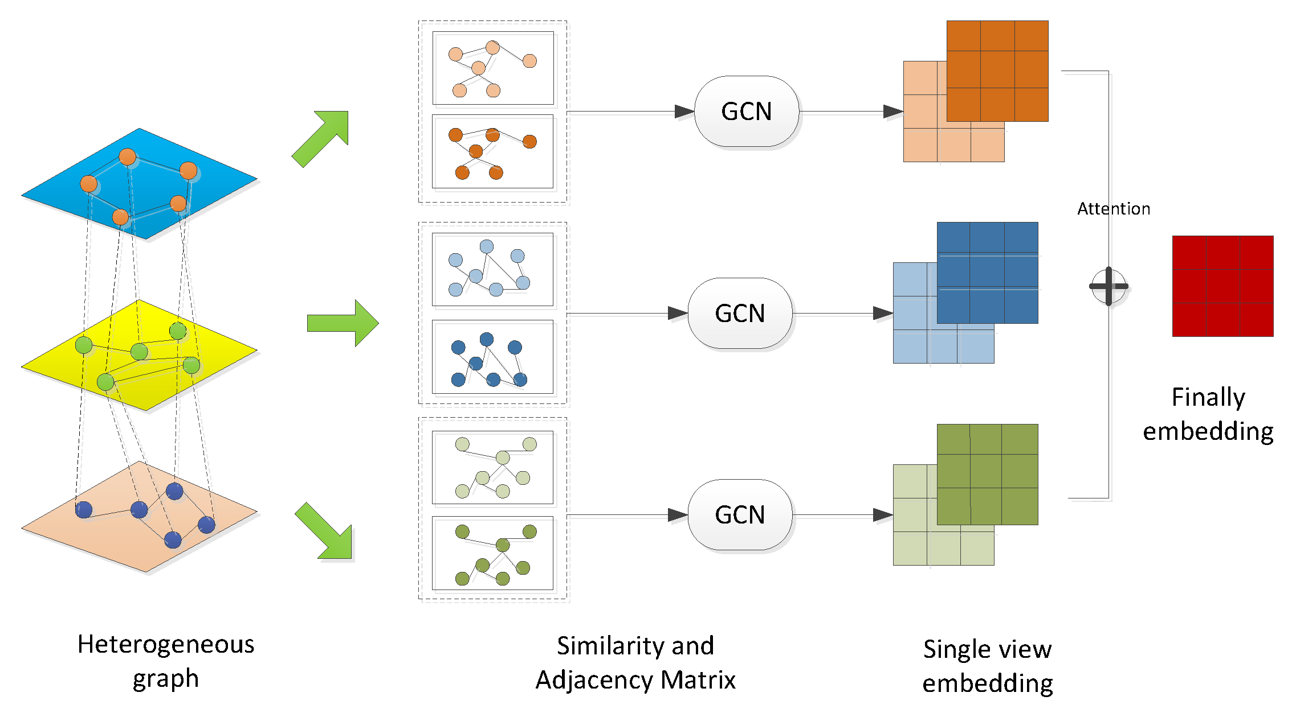
SYSTEM ARCHITECTURE

Slide 11

SCREEN SHOTS

Slide 12
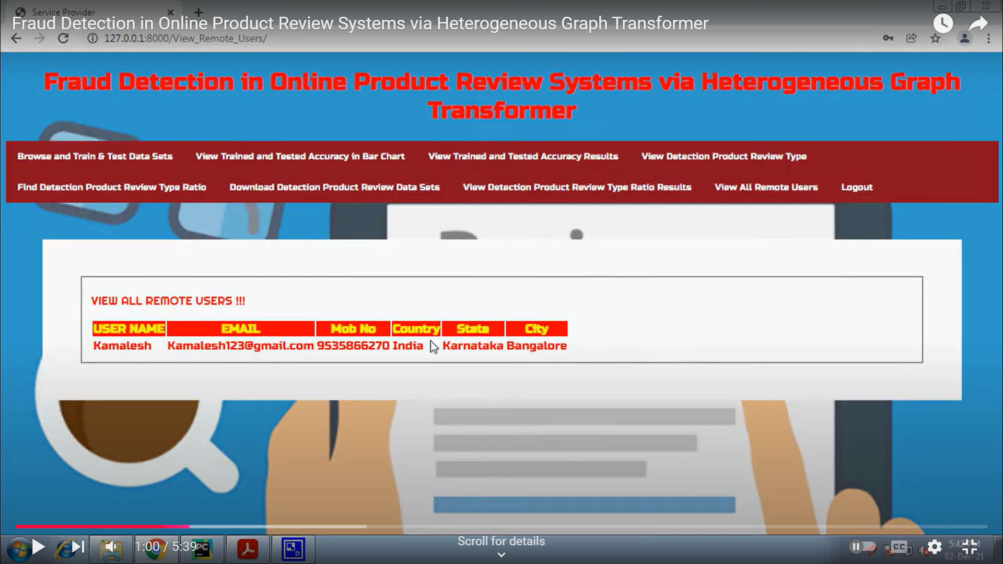

Slide 13


Slide 14
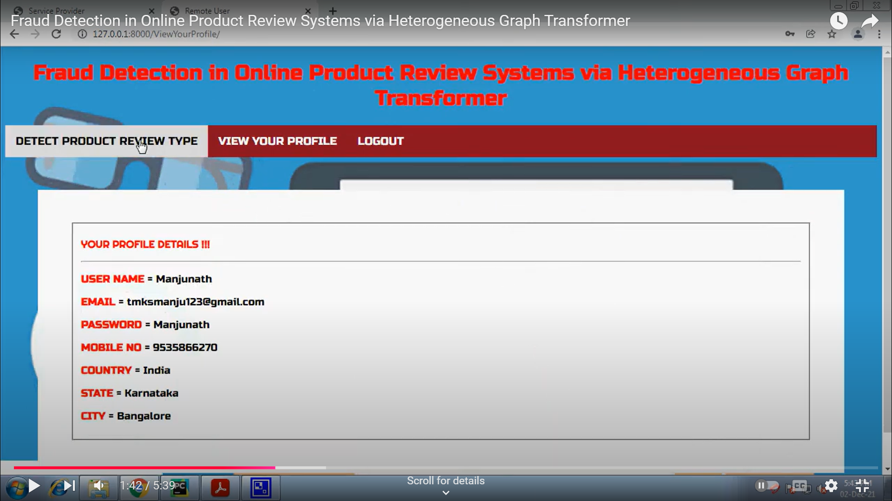

Slide 15
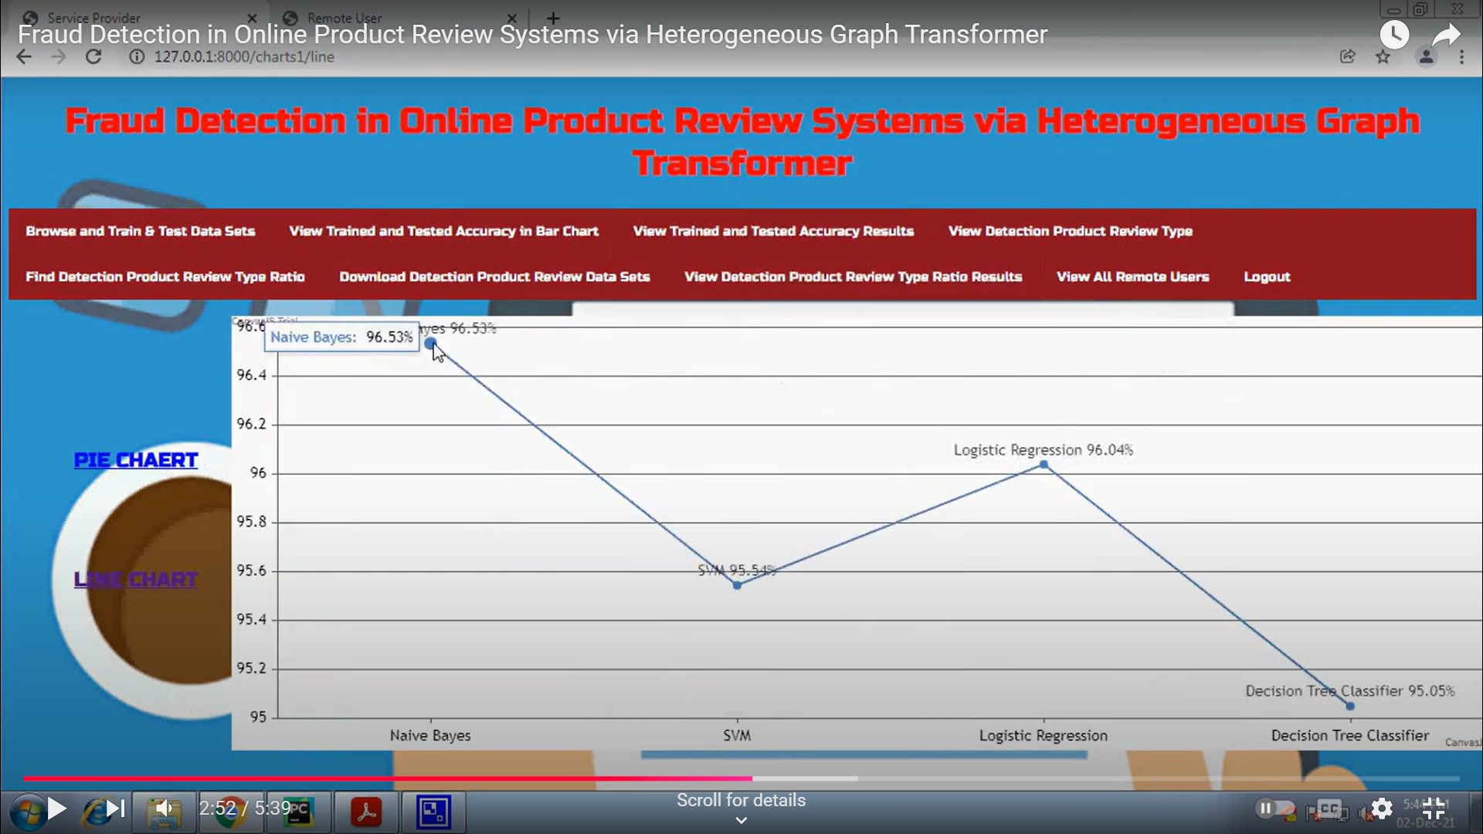

Slide 16
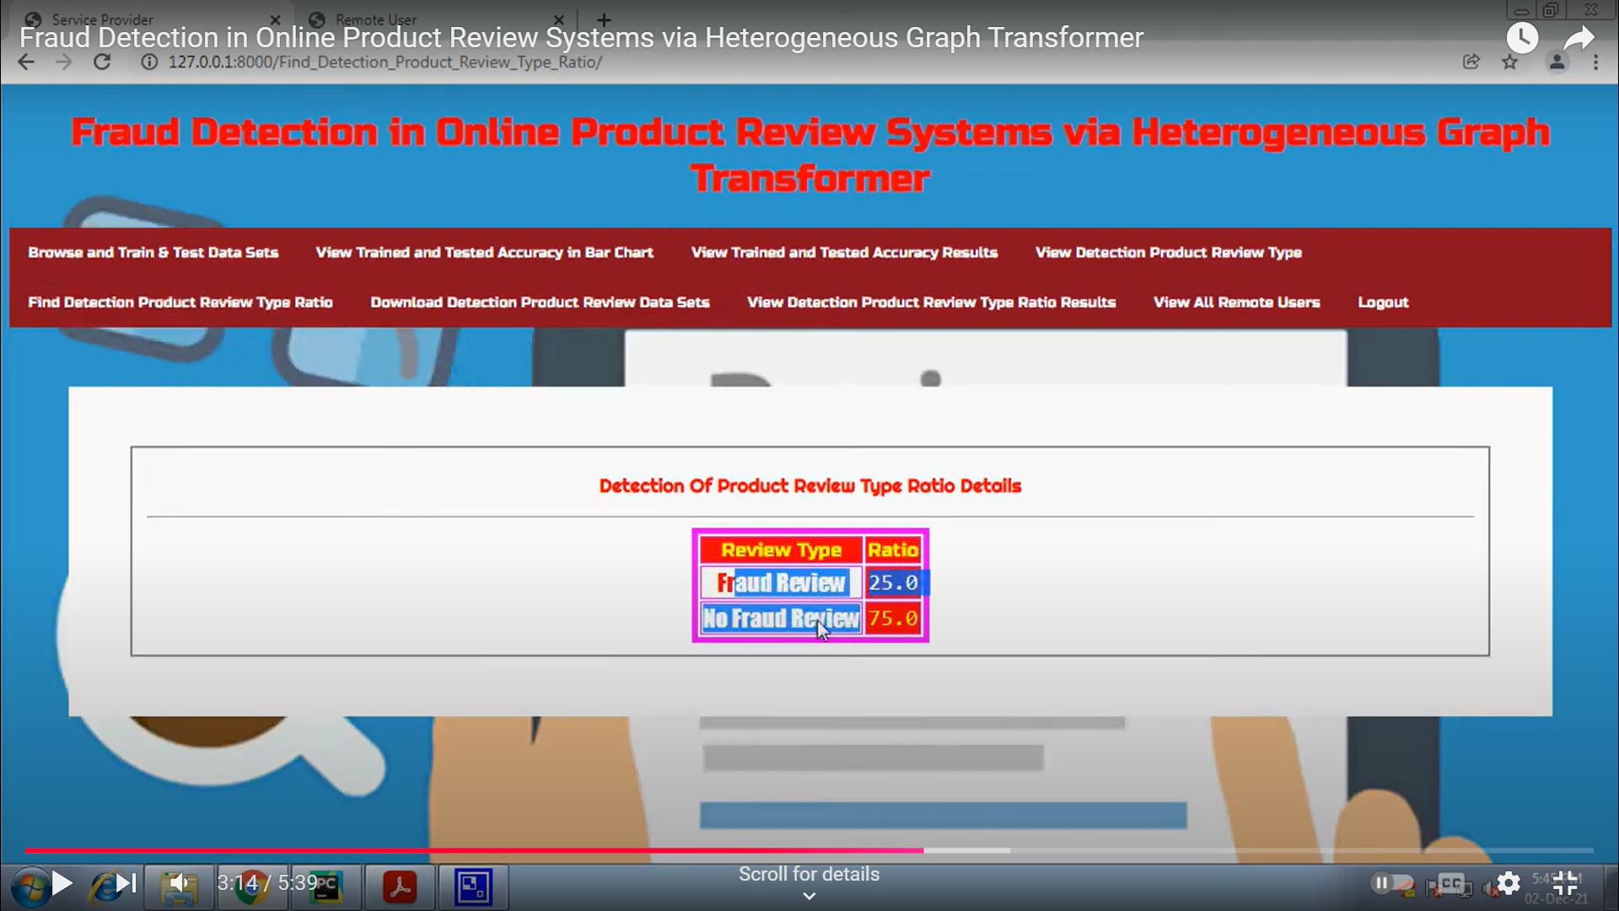

Slide 17
Conclusion
The proposed Heterogeneous Graph Transformer (HGT) model represents a significant advancement in fraud detection for online product review systems, addressing many of the limitations of traditional fraud detection methods.
By leveraging the power of heterogeneous graphs and transformer architectures, the system is able to model complex, multi-relational interactions between users, products, and reviews, which are essential for identifying subtle and sophisticated fraudulent behaviors.
Furthermore, the scalability of the proposed system ensures that it can efficiently handle the large volumes of data typical in modern e-commerce platforms. As online platforms continue to grow, the system is capable of scaling with minimal increases in computational cost, maintaining robust performance even as the volume of users, products, and reviews increases.
This scalability, combined with the system’s adaptability, makes it well-suited for real-time fraud detection and capable of evolving alongside emerging fraud tactics. As fraudsters continue to refine their strategies, the system’s ability to dynamically adjust and learn from new data ensures that it remains effective over time.
In conclusion, the Heterogeneous Graph Transformer-based fraud detection system offers a powerful, scalable, and interpretable solution for detecting fraudulent activities in online product review systems. Its ability to capture complex relationships, improve detection accuracy, and adapt to new fraudulent tactics positions it as a valuable tool for ensuring the integrity and trustworthiness of online reviews.
As e-commerce platforms continue to expand and fraud becomes increasingly sophisticated, this approach promises to play a vital role in maintaining a fair and reliable review ecosystem, ultimately benefiting both consumers and businesses.

Slide 18
References
Jindal, N., & Liu, B. (2008). Analyzing and Detecting Review Spam. Proceedings of the 2008 International Conference on Web Search and Data Mining (WSDM).
Hu, J., & Liu, L. (2012). Detecting Fake Reviews through User Behavior and Review Content. Proceedings of the 2012 International Conference on Data Mining.
Liu, B., & Seneviratne, O. (2017). Review Spam Detection with Deep Learning Models. Proceedings of the 2017 IEEE International Conference on Big Data..
Zhang, L., & Zhang, X. (2019). Fraudulent Review Detection on E-commerce Platforms Using Graph-based Models. International Journal of Computer Science and Information Security.
Ribeiro, M. T., Santos, M. L., & Almeida, J. M. (2020). Using Graph Neural Networks for Fake Review Detection in E-commerce. International Conference on Knowledge Discovery and Data Mining (KDD).

